Slide 1

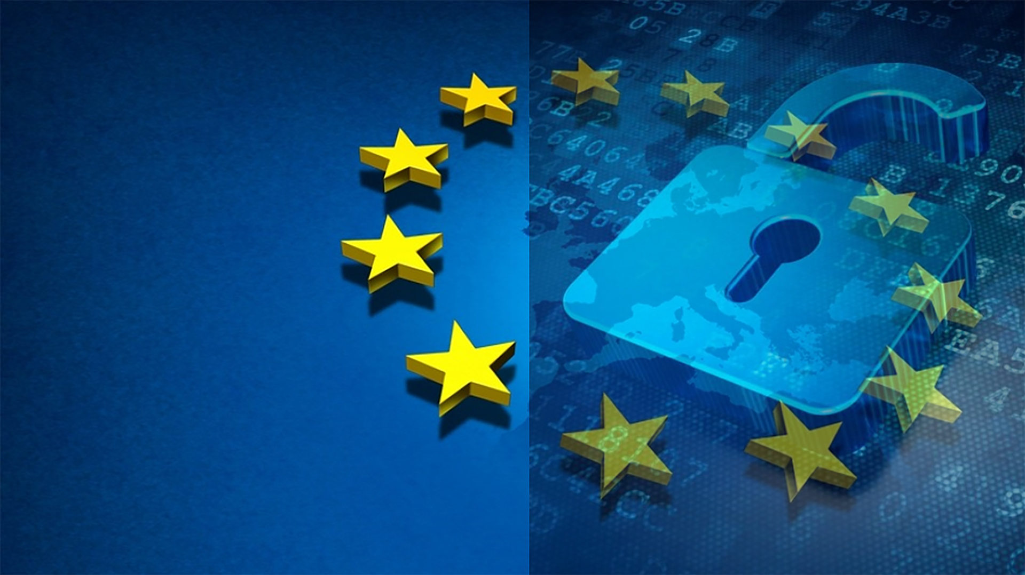
Microsoft GDPR Detailed Assessment – v3.0 Oct 2018
Engagement kickoff
<your name>
This presentation is intended to provide an overview of the Microsoft GDPR Detailed Assessment and is not a definitive statement of the law.

Slide 2
Version History & Updates
hidden slide
V | Date | Who | What
1.2 | 30-06-2017 | Various | First public version delivered.
1.3 | 13-07-2017 | François van Hemert | Various updates to align with delivery guide. Added section on Assessment tool; formatting & layout; speaker notes Added generic GDPR slides from GDPR Customer Presentation to introduce GDPR
1.8 | 12-09-2017 | François van Hemert | Minor changes/updates
1.9 | 18-09-2017 | François van Hemert | Submitted for CELA review
2.0 | 04-10-2017 | François van Hemert | Published version
3.0 | 29-03-2018 | François van Hemert | Added compliance manager integration
Please keep this page up to date!
Notes:
This deck is frequently updated with new insights and feedback from the field. Please keep version history up to date.

Slide 3
Microsoft GDPR Detailed Assessment
hidden slide
Workshop | Description | Resources
Step 1
Pre-engagement meeting (on-line) | Introduction to the Microsoft GDPR Detailed assessment, discuss upcoming activities, align expectations and timelines. High level introduction to GDPR. Preview of the Microsoft GDPR Detailed Assessment questions to help identify the customer representatives that will assist in answering. | 00 - Microsoft GDPR Detailed Assessment - Delivery Guide 01 - Microsoft GDPR Detailed Assessment – Pre Engagement Presentation
Step 2
Engagement Kickoff (on-site) | Kick off meeting to introduce (new) team members, brief the team on upcoming activities. Confirm meeting schedules and locations | 00 - Microsoft GDPR Detailed Assessment - Delivery Guide 02 - Microsoft GDPR Detailed Assessment – Engagement Kickoff Presentation (this deck)
GDPR Detailed Assessment | Complete discussion of the questions contained within the Microsoft GDPR Detailed Assessment | 00 - Microsoft GDPR Detailed Assessment - Delivery Guide 03 - Microsoft GDPR Detailed Assessment – Detailed Assessment tool
Outcome Analysis and Write-Up | Analyze and document results of the assessment, prepare the close out presentation. | 00 - Microsoft GDPR Detailed Assessment - Delivery Guide 04 - Microsoft GDPR Detailed Assessment – Closeout Presentation
Step 3
Close-out presentation | Present the findings from the assessment to the customer and define next steps and if possible a roadmap towards GDPR compliance. | 00 - Microsoft GDPR Detailed Assessment - Delivery Guide 04 - Microsoft GDPR Detailed Assessment – Closeout Presentation
Notes:
The detailed assessment is built on three steps that are discussed and detailed in the “00 - Microsoft GDPR Detailed Assessment - Delivery Guide”.
For detailed information and background refer to the delivery guide
This presentation is intended to be used during the onsite kickoff meeting.

Slide 4
Intended usage
This model is a question-driven assessment tool for preparing for the General Data Protection Regulation (GDPR) (Regulation (EU) 2016/679). The tool is intended to be used by Microsoft partners to assist customers in identifying where they are on the journey to GDPR readiness. Output from the tool includes identification of gaps in customer readiness and recommendations to consider for closing any gaps. Recommendations are organized into the categories People, Process and Technology.
Disclaimer
This GDPR Detailed Assessment is intended to assist organizations with assessing their GDPR compliance progress. This GDPR Detailed Assessment is provided for general public informational purposes only. Any results, scoring or recommendations produced by the GDPR Detailed Assessment should not be relied upon to determine how GDPR applies to an organization or an organization’s compliance with GDPR, and they do not constitute legal advice, certifications or guarantees regarding GDPR compliance. Instead, we hope the GDPR Detailed Assessment identifies technologies and additional steps that organizations can implement to simplify their GDPR compliance efforts. The application of GDPR is highly fact-specific. We encourage all organizations using this GDPR Detailed Assessment to work with a legally qualified professional to discuss GDPR, how it applies specifically to their organization, and how best to ensure compliance.
MICROSOFT MAKES NO WARRANTIES, EXPRESS, IMPLIED, OR STATUTORY, AS TO THE INFORMATION IN THIS GDPR DETAILED ASSESSMENT. Microsoft disclaims any conditions, express or implied, or other terms that use of the Microsoft products or services will ensure the organization’s compliance with the GDPR. This GDPR Detailed Assessment is provided “as-is.” Information and recommendations expressed in this GDPR Detailed Assessment may change without notice.
This GDPR Detailed Assessment does not provide the user with any legal rights to any intellectual property in any Microsoft product or service. Use of the tool is for internal, reference purposes only; however, Microsoft partners may distribute the GDPR Detailed Assessment to their customers for such customers’ internal, reference purposes only. Any distribution of the GDPR Detailed Assessment by a Microsoft partner to its customers must include terms consistent with those set forth in this disclaimer.
© 2017 Microsoft. All rights reserved
Notes:
Discuss the disclaimer and its intention with your customer. It is important to emphasize the information contained in the disclaimer.

Slide 5
Agenda
Introduction
1
Privacy, Trust, and the General Data Protection Regulation
2
Introducing the Microsoft GDPR Detailed Assessment
3
Engagement Overview
4
The Microsoft GDPR Assessment Tool
5
Project Governance
6

Slide 6
Introduction

Slide 7

Introduction
The purpose of this meeting is to
Introduce the Microsoft GDPR Detailed Assessment
Activities & Deliverables
Tools
Timelines and workflow
Introduce the (new) team members
Outline responsibilities
Confirm availability
Align expectations
Review and agree on engagement
Goals, scope and deliverables
Schedule and Timelines
Customer requirements
Expectations and next steps
Agree on project governance
Notes:
The kickoff meeting marks the start of the two day onsite engagement, discuss the following topics:
Introduce the Microsoft GDPR Detailed Assessment → first step towards GDPR compliance, not intended to scan data but to assess maturity of people, process and technology
Activities & Deliverables → briefly describe what we will be doing and the expected outcome
Tools → we will be using the assessment tool that will be discussed in detail later on
Timelines and workflow
Introduce the (new) team members → not all participants have been part of the pre-engagement meeting, we need to repeat some of the topics to bring them up to speed
Outline responsibilities → we have a tight and very short timeline, it is essential that participants are available at requested times and are commited to providing complete and correct answers
Confirm availability
Align expectations
Review and agree on engagement
Goals, scope and deliverables
Schedule and Timelines
Customer requirements
Expectations and next steps
Agree on project governance

Slide 8

Team Introductions
Name
Please share your name and where are you based?
Role
Please share your role in the company, which business unit or team you are part of, what other roles have you had? (Internal/External)
Expectations
Please share your expectations of the session?
Notes:
Ask everyone on the meeting to present themselves.
Note takers should capture this information in the provided template.
Limit to 30 seconds per person.
It is important to understand the role of the attendees, this will help in identifying the right responders for the questionnaire.

Slide 9
Privacy, Trust, and the General Data Protection Regulation (GDPR)

Slide 10
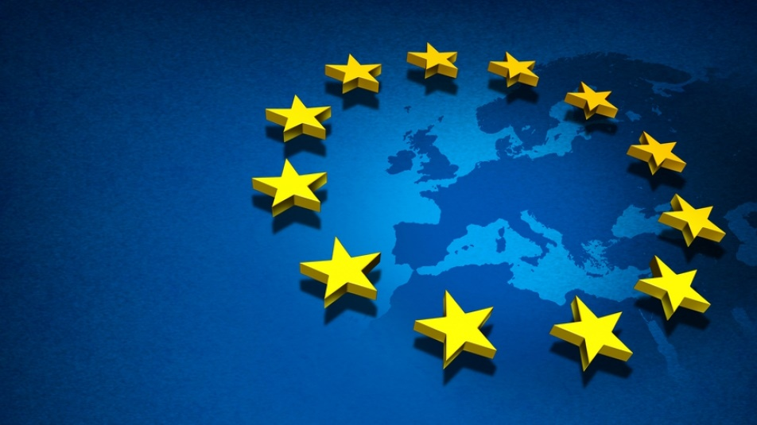
Providing clarity and consistency for the protection of personal data
The General Data Protection Regulation (GDPR) imposes new rules on organizations that offer goods and services to people in the European Union (EU), or that collect and analyze data tied to EU residents, no matter where they are located.
Enhanced personal privacy rights
Increased duty for protecting data
Mandatory breach reporting
Significant penalties for non-compliance
Microsoft believes the GDPR is an important step forward for clarifying and enabling individual privacy rights
Notes:
Presenter guidance:
Use this slide to define the GDPR and introduce why it is such a big a change.
Key takeaways:
The GDPR modernizes data protection laws and individual privacy rights for the first time in 20 years. Current laws are based on a directive from 1995. With the increased digitization of our world and its privacy implications, the importance of modernizing privacy regulations to protect citizens has become imperative.
After four years of debate, the GDPR was agreed upon and given a two-year implementation period to give organizations time to prepare for compliance. GDPR is directly applicable to all EU member states and enforcement begins on 25 May 2018.
The GDPR applies broadly, to organizations of all sizes and types, including large and small businesses and public authorities. The GDPR also has broad territorial application and could apply to your organization even if you are processing personal data outside of the EU or are processing personal data of non-EU residents. Specifically, the GDPR applies to:
The processing of anyone’s personal data where that processing is done in the context of the activities of an organization established in the EU (regardless of where the processing actually takes place).
The processing of personal data of individuals in the EU by an organization established outside the EU, where that processing relates to the offering of goods or services to those individuals or to the monitoring of their behavior.
Microsoft believes the GDPR represents an important step forward for individual privacy rights. And these stronger protections are supported by stronger enforcement powers and the potential for significant fines for non-compliance.
The GDPR is a complex regulation that may require significant changes in how organizations collect, process, and manage data. Microsoft has a long history of helping our customers comply with complex regulations.
We treat this as an opportunity for Microsoft to support its customers with products and services will help make their compliance easier.

Slide 11

What are the key changes with the GDPR?
Personal privacy
Controls and notifications
Transparent policies
IT and training
Individuals have the right to:
Access their personal data
Correct errors in their personal data
Erase their personal data
Object to processing of their personal data
Export personal data
Processors will need to:
Protect personal data using appropriate security practices
Notify authorities within 72 hours of breaches
Receive consent before processing personal data
Keep records detailing data processing
Processors are required to:
Provide clear notice of data collection
Outline processing purposes and use cases
Define data retention and deletion policies
Processors will need:
Train privacy personnel & employee
Audit and update data policies
Employ a Data Protection Officer (for larger organizations)
Create & manage processor/vendor contracts
Notes:
Presenter guidance:
Use this slide to dive deeper into the changes being introduce with GDPR and the potential impact organizations are going to face.
Key takeaways:
The GDPR contains many requirements about how you collect, store, and use personal information. This means not only how you identify and secure the personal data in your systems, but also how you accommodate new transparency requirements, how you detect and report personal data breaches, and how you train privacy personnel and employees.
We’ve categorized the changes into 4 buckets:
Individual Privacy Rights:
The GDPR strengthens personal privacy rights for individuals within the EU— 5 main rights for individuals that you are I would want as data subjects.
Access their personal data—The GDPR gives individuals rights to a copy of their personal data, an explanation of the categories of data being processed (e.g., location data, browsing history, demographic data, voice data, biometric data, etc), the purpose of the data processing, and any third parties that might receive that data.
Correct errors in their personal data (rectification)—Individuals can require corrections to their personal data.
Right to erasure—Individuals can require deletion of their personal data where it is no longer needed for the purpose for which it was initially collected or in the event consent is withdrawn there is no other legal ground for the processing. This means data needs to be removed not just from databases, but all backups and archives.
Object to the processing of their personal data—In cases where data cannot be deleted because it is necessary for other legitimate purposes (such as a legal hold, protection of another’s rights, etc...) an individual can require that the data not be processed and that it is simply stored.
Move their information (also known as Data Portability)—An individual should be able to get a copy of his or her personal data and move it to another provider. Individuals have a right to receive personal data in a structured, commonly-used and machine-readable format.
Controls and notifications:
Introduces strict security requirements—The GDPR requires organizations to protect personal data in order to “prevent any unlawful forms of processing, in particular any unauthorized disclosure, dissemination or access, or alteration of personal data.” This means data controllers and processors need to implement appropriate technical (such as encryption) and organizational (for example, limiting the number of people inside your organization who can access data) measures to ensure a level of security appropriate to the risk including:
Personal data (paricularly sensisitive personal data – religion/ethnic origin, genetic data, biometric data, and health data) is encrypted/pseudonymized (personal data can no longer be attributed to a specific data subject without the use of additional information, provided that such additional information is kept separately).
Processing systems and services maintain data confidentiality.
Deleted/lost personal data can be restored in a timely manner in the event of a physical or technical incident.
Security measures are routinely tested for competency and effectiveness
Breach detection and prevention tools are in place.
Breach notification obligation—Data controllers must notify supervisory authorities (generally, the applicable data protection authority) of data breaches without undue delay and in any event within 72 hours after discovery. Data subjects will also have to be notified without undue delay if the personal data breach poses a “high risk” to their “rights and freedoms.” Data processors, like Microsoft in the context of enterprise online services, must notify controllers of a persoanl data breach “without undue delay.”
Carry out data protection impact assessments for high risk processing—Organizations must carry out data protection impact assessments where processing activities present high risks to the rights and freedoms of individuals. These assessments generally involve identifying and documenting privacy risks raised by proposed processing, and planning mitigation measures to help control and minimize those risks. In some cases, organizations must also consult data protection authorities before undertaking processing.
Recordkeeping—The GDPR requires that large organizations maintain detailed internal records of processing activities. This includes records about the purposes of processing, the categories of personal data processed, transfers of personal data outside the European Economic Area, and the security measures employed to protect data.
Transparent policies:
The GDPR includes detailed rules on what an organization must tell individuals about its data processing. This includes, among other things, information about why the personal data is being processed, how long the data will be stored, with whom the personal data will be shared, and whether the personal data will be transferred outside the European Economic Area. This information must be presented in a way that is clear and easily accessible. Organizations should review their disclosures against the GDPR’s requirements carefully.
IT and Training:
And finally, compliance with the GDPR will require organizational Training and IT/Vendor management

Slide 12



What does this mean for my data?
Stricter control on where personal data is stored and how it is used
Better data governance tools for better transparency, recordkeeping and reporting
Protecting customer privacy with GDPR
Improved data policies to provide control to data subjects and ensure lawful processing
Notes:
Presenter guidance:
Use this slide to translate how those key changes are going to affect how organization’s store, use and manage personal data.
Key takeaways:
With the GDPR, organizations will need to have tighter controls on how they manage and collect personal data. Systems and processes will need to be updated or put in place to prevent unlawful use of data (primarily around processing data without the data subject’s consent) and to ensure the way it is stored and used is compliant. Additionally, because data subjects now have the legal right to correct, withdraw consent, request deletion or ask for a copy of their data, organizations will need to have the proper tools and systems in place to accommodate these requirements.
Organizations will also need implement more advanced data policies to ensure that they are being compliant with their use of personal data, but also enable them to accommodate the new transparency, recordkeeping and reporting requirements. Organizations that take a privacy by design approach to improve their data policies will be better prepared to prevent data breaches, report on their GDPR compliance, and perform data impact risk assessments.
With the GDPR’s high penalties for non-compliance, data governance tools will be extremely important to ensure organizations can provide an audit trail to prove compliance, expose areas of risk before they become a problem, and effectively and legally respond to data breaches.

Slide 13

Microsoft’s commitment to its customers
To simplify your path to compliance, Microsoft is committing to GDPR compliance across her cloud services when enforcement begins on May 25, 2018.
Microsoft will share her experience in complying with complex regulations such as the GDPR.
Together with her partners, Microsoft is prepared to help you meet your policy, people, process, and technology goals on your journey to GDPR.
Notes:
Presenter guidance:
Use this slide to re-state Microsoft’s GDPR commitment to customers.

Slide 14










Preparing for the GDPR
GDPR Compliance
GDPR Compliance
GDPR Compliance
Simplify your privacy journey
Elevate your privacy practices with the Microsoft cloud
Uncover risk & take action
Use Microsoft solutions to expose areas of risk and respond with agility and confidence
Leverage guidance from experts
Use the Microsoft partner network to help you meet your privacy, security, and compliance goals
Notes:
Presenter guidance:
Use this slide to articulate Microsoft’s unique value proposition in a customer’s journey towards GDPR compliance.
Simplify your compliance journey:
Our cloud services offer the most streamlined way for customers to meet their GDPR compliance obligations. With a global datacenter footprint, an industry-leading largest certified compliance portfolio, and services architected to be secure by design, Microsoft cloud services provide customers a more simplified and complete approach to the governance of their data and data policies. For example, utilizing our cloud services will:
Make it easier to locate and identify the personal data you collect, simplifying your ability to find and evaluate the data across your organization.
Make it possible to centralize processing by more effectively managing applicable policies, data categorizations and use cases.
Provide threat intelligence and tools to help you leverage that intelligence, benefiting your security efforts.
Centralize and streamline technical and administrative steps required for compliance such as demonstrating due diligence and handling data access requests.
Uncover risk & take action:
We want to help you focus on your core business while efficiently preparing for the GDPR. Our goal is to streamline your GDPR compliance through smart technology, innovation and collaboration. While we are working to ensure our products and services are fully GDPR compliant by May 25, 2018, many of our products and services can help get started today your compliance journey today. Our data solutions can help secure and clean up your data environment, reducing your exposure to risk.
Additionally, our rights management and content management solutions can help ensure your personal data is being stored in the right location and only being access by authorized users.
Lastly, our data governance solutions embedded in services like Office 365 and SQL Server, can help you seek out non-compliant areas of your environment and provide the necessary capabilities to bring those areas into compliance.
Leverage guidance from experts:
You can count on our extensive global partner ecosystem for expert support as you use Microsoft technologies. Our partners can:
Help you perform security and risk assessments, locate relevant personal data, and develop a plan to achieve and maintain compliance.
Help you develop, implement, and manage your compliance plan by designing, configuring and monitoring the policies and controls appropriate for your data and applications.
Monitor, analyze and action threat intelligence and user behavior information to ensure that vulnerabilities and breaches are effectively addressed.
Offer administrative services to ensure you meet your documentation requirements and notification obligations are respond expediently to data requests.

Slide 15

How do I get started?
Discover
Identify what personal data you have and where it resides
1
Manage
Govern how personal data is used and accessed
2
Protect
Establish security controls to prevent, detect, and respond to vulnerabilities & data breaches
3
Report
Keep required documentation, manage data requests and breach notifications
4
Notes:
Presenter guidance:
Use this slide to educate how customers can get started on their journey to GDPR compliance.
Key takeaways:
Given how much is involved, you should not wait until the regulation takes effect in May 2018 to prepare. You need to begin reviewing your privacy and data management practices now. Failure to comply with the GDPR could prove costly, as companies that do not meet the requirements and obligations could face substantial fines and reputational harm.
We recommend companies begin their journey to GDPR compliance by focusing on four key pillars of an effective data protection regime:
Discover—Identify what personal data you have and where it resides.
Manage—Determine how personal data is used and accessed.
Protect—Establish security controls to prevent, detect, and respond to vulnerabilities and data breaches.
Report— Execute on data requests, report data breaches, and keep required documentation.

Slide 16
Audit Logs
Intune
Active Directory
Threat Intelligence
Office
eDiscovery
Log Analytics
EMS
Data Log
Data Loss Prevention
Microsoft Azure
SOLUTIONS TO HELP YOU
Key Vault
Cloud App Security
PREPARE FOR THE GDPR
Windows
Data Classification
Threat Detection
SQL
Windows Server
Windows Hello
Credential Guard
Information Protection
Transparent Data Encryption
Always Encrypted
Notes:
Presenter guidance:
Use this slide to illustrate the breadth of our solution offerings that can help our customers on their GDPR compliance journey.
Key takeaways:
Our extensive portfolio of solutions offer our customers a holistic set of capabilities to help meet their GDPR obligations. These capabilities just stretch across all of our platforms and core products, enabling our customers to utilize compliant solutions for all aspects of their business.
To help explain how all of these solutions work together, let’s take a look at how a small subset of capabilities can help you discover your personal data, manage how it is used and access, protect it from vulnerabilities, and keep healthy data records to meet your GDPR transparency, data request and record-keeping requirements.

Slide 17

Discover: Identify what personal data you have and where it resides
1
Example solutions
Microsoft Azure
Microsoft Azure Data Catalog
Enterprise Mobility + Security (EMS)
Microsoft Cloud App Security
Dynamics 365
Audit Data & User Activity
Reporting & Analytics
Office & Office 365
Data Loss Prevention
Advanced Data Governance
Office 365 eDiscovery
SQL Server and Azure SQL Database
SQL Query Language
In-scope:
Any data that helps you identify a person
Name
Email address
Social media posts
Physical, physiological, or genetic information
Medical information
Location
Bank details
IP address
Cookies
Cultural identity
Inventory:
Identifying where personal data is collected and stored
Emails
Documents
Databases
Removable media
Metadata
Log files
Backups
Notes:
Presenter guidance:
Use this slide to showcase solution capabilities in the Discovery phase that can help our customer meet their GDPR obligations.
Key takeaways:
The first step towards GDPR compliance is to assess whether the GDPR applies to your enterprise, and, if so, to what extent. This analysis starts with understanding what data you have and where it resides.
The GDPR regulates the collection, storage, use, and sharing of “personal data.” Personal data is defined very broadly under the GDPR as any data that relates to an identified or identifiable natural person.
If your enterprise has such data—in customer databases, in feedback forms filled out by your customers, in email content, in photos, in CCTV footage, in loyalty program records, in HR databases, or anywhere else—or wishes to collect it, and if the data belongs or relates to EU residents, then you need to comply with the GDPR. Note that personal data doesn’t need to be stored in the EU to be subject to the GDPR—the GDPR applies to data collected, processed, or stored outside the EU if the data is tied to EU residents.
To understand whether the GDPR does apply to your enterprise and, if it does, what obligations it imposes, it is important to inventory your organization’s data. This will help you to understand what data is personal, and to identify the systems where that data is collected and stored, understand why it was collected, how it is processed and shared, and how long it is retained.
Utilizing capabilities from our solutions Microsoft Azure, Office 365, Dynamics 365, Windows and Windows Server, Enterprise Mobility + Security Suite (EMS), and SQL, we can help you discover and catalog personal data sources across your entire environment—whether on devices and platforms or in databases and apps (e.g. enhanced data governance in O365 allows you discover and delete data in compliance with individual privacy rights).
Here are examples of specific ways that that our cloud and on-premises offerings can help you with the GDPR’s first step.
Microsoft Azure:
As Azure is an open and flexible cloud platform, it includes a service to help make data sources easily discoverable and identifiable. The Microsoft Azure Data Catalog is a fully managed cloud service that serves as a system of registration and system of discovery for enterprise data sources. In other words, Azure Data Catalog is all about helping you discover, understand, and use data sources to get more value from your existing data. Once a data source has been registered with Azure Data Catalog, its metadata is indexed by the service so that you can easily search to discover the data you need.
Enterprise Mobility + Security:
Microsoft Cloud App Security is a comprehensive service that provides deeper visibility, comprehensive controls, and improved protection for your data in your cloud applications. You can have visibility to which cloud apps are in use in your network—identifying over 13,000 apps from all devices—and get risk assessments and ongoing analytics.
Dynamics 365
Dynamics 365 provides several visibility and auditing capabilities that can be used through the Reporting & Analytics dashboards of Dynamics 365 to identify personal data:
Dynamics 365 includes a Report Wizard that you can use to easily create reports without using XML or SQL-based queries.
Dashboards in Dynamics 365 provide an overview of business data—actionable information that’s viewable across your organization.
Microsoft Power BI is a self-service business intelligence (BI) platform you can use to discover, analyze, and visualize data, and share or collaborate on these insights with colleagues.
Office & Office 365:
Data Loss Prevention (DLP) in Office and Office 365 can identify over 80 common sensitive data types including financial, medical, and personally identifiable information.
Office 365 eDiscovery search can be used to find text and metadata in content across your Office 365 assets—SharePoint Online, OneDrive for Business, Skype for Business Online, and Exchange Online.
Office 365 Advanced eDiscovery, powered by machine learning technologies, can help you identify documents that are relevant to a particular subject (for example, a compliance investigation) quickly and with better precision than traditional keyword searches or manual reviews of vast quantities of documents. Advanced eDiscovery can significantly reduce cost and effort to identify relevant documents and data relationships by using machine learning to train the system to intelligently explore large datasets and quickly zero in on what’s relevant—reducing the data prior to review.
Advanced Data Governance uses intelligence and machine-assisted insights to help you find, classify, set policies on, and take action to manage the lifecycle of the data that is most important to your organization.
SQL Server and Azure SQL Database:
The SQL language can be used to query databases and to customize tools or services that may help enable this requirement. Search is fully supported through queries, although full trace logging should be done at the application level. The Script task provides code to perform custom functions, such as complex data queries that are not available in the built-in tasks and transformations that SQL Server Integration Services provides. The Script task can also combine functions in one script instead of using multiple tasks and transformations. This product suite also includes powerful business intelligence functionality providing end-user access to data insights.

Slide 18
2
Manage: Govern how personal data is used and accessed within your organization
Example solutions
Microsoft Azure
Azure Active Directory
Azure Role-Based Access Control (RBAC)
Enterprise Mobility + Security (EMS)
Azure Information Protection
Dynamics 365
Security Concepts
Office & Office 365
Advanced Data Governance
Journaling (Exchange Online)
Windows & Windows Server
Microsoft Data Classification Toolkit
Data governance:
Defining policies, roles and responsibilities for the management and use of personal data
At rest
In process
In transit
Storing
Recovery
Archiving
Retaining
Disposal
Data classification:
Organizing and labeling data to ensure proper handling
Types
Sensitivity
Context / use
Ownership
Custodians
Administrators
Users
Notes:
Presenter guidance:
Use this slide to showcase solution capabilities in the Manage phase that can help our customer meet their GDPR obligations.
Key takeaways:
The GDPR provides data subjects—individuals to whom data relates—with more control of how their personal data is captured and used. Data subjects can, for example, request that your enterprise share data that relates to them, transfer their data to other services, correct mistakes in their data, or restrict certain data from further processing in certain cases. In some cases, these requests must be addressed within fixed time periods.
In order to satisfy your obligations to data subjects, you will need to understand what types of personal data your enterprise processes, how, and for what purposes. The data inventory discussed previously is a first step to achieving this understanding. Once that inventory is complete, it is also important to develop and implement a data governance plan. A data governance plan can help you define policies, roles, and responsibilities for the access, management, and use of personal data, and can help you ensure your data handling practices comply with the GDPR. For example, a data governance plan can give your enterprise confidence that it effectively respect data subject demands to delete or transfer data.
Data classification is an important part of any data governance plan. Adopting a classification scheme that applies throughout your enterprise can be particularly helpful for responding to data subject requests, because it enables you to identify more readily and process personal data requests.
We provide controls to ensure how data is managed and to ensure that you control who has access to what data within your organization—utilizing capabilities such as advanced identity and management solutions for your on-premises, cloud and hybrid resources, and advanced data governance capabilities to help you find, classify, set policies on, and manage data throughout its lifecycle (e.g. Azure information protection enables you to classify info with tags so a GDPR compliance policy can be applied to it).
Pick and choose which products to call out from italics text below, depending on customer audience:
Here are examples of specific ways that that our cloud and on-premises offerings can help you classify and govern your data.
Microsoft Azure:
Azure Active Directory is an identity and access management solution in the cloud. It manages identities and controls access to Azure, on-premises, and other cloud resources, data, and applications. With Azure Active Directory Privileged Identity Management, you can assign temporary, Just-In-Time (JIT) administrative rights to eligible users to manage Azure resources.
Azure Role-Based Access Control (RBAC) helps you manage access to your Azure resources. This enables you to grant access based on the user’s assigned role, making it easier to grant only the required permissions that users need to perform their jobs. You can customize RBAC per your organization’s business model and risk tolerance.
Enterprise Mobility + Security:
Azure Information Protection can help you classify and label your data at the time of creation or modification. Protection (encryption plus authentication plus use rights) or visual markings can then be applied to sensitive data. Classification labels and protection are persistent, traveling with the data so that it’s identifiable and protected at all times—regardless of where it’s stored or with whom it’s shared.
Dynamics 365
The Dynamics 365 (online) security and compliance planning guide provides comprehensive guidance on understanding the key compliance and security considerations associated with planning for a deployment of Dynamics 365 (online) in environments that include enterprise directory integration services such as directory synchronization and single sign-on. It includes information on data privacy and confidentiality policies, data classification, and impact.
Office & Office 365:
Advanced Data Governance uses intelligence and machine-assisted insights to help you find, classify, set policies on, and take action to manage the lifecycle of the data that is most important to your organization. Classify data based on automatic analysis and policy recommendations, then apply actions to preserve data in-place or purge what's necessary. In-place data as well as third-party data sources can be ingested into Office 365 and classified by message type. Message type classification allows for the search, sort, and export of the various data sources, which eases the process of performing e-discovery reviews.
Journaling in Exchange Online can help you respond to legal, regulatory, and organizational compliance requirements by recording inbound and outbound email communications.
Windows and Windows Server:
The Microsoft Data Classification Toolkit for Windows Server 2012 R2 provides sample search expressions and rules that you can use to assist compliance activities conducted by your organization’s IT professionals, auditors, accountants, attorneys, and other compliance professionals.

Slide 19
3
Protect: Establish security controls to prevent, detect, and respond to vulnerabilities and data breaches
Example solutions
Microsoft Azure
Azure Key Vault
Enterprise Mobility + Security (EMS)
Azure Active Directory Premium
Microsoft Intune
Office & Office 365
Advanced Threat Protection
Threat Intelligence
SQL Server and Azure SQL Database
Transparent data encryption
Always Encrypted
Windows & Windows Server
Windows Defender Advanced Threat Protection
Windows Hello
Credential Guard
Preventing data attacks:
Protecting your data
Physical datacenter protection
Network security
Storage security
Compute security
Identity management
Access control
Encryption
Risk mitigation
Detecting & responding to breaches:
Monitoring for and detecting system intrusions
System monitoring
Breach identification
Calculating impact
Planned response
Disaster recovery
Notifying DPA & customers
Notes:
Presenter guidance:
Use this slide to showcase solution capabilities in the Protect phase that can help our customer meet their GDPR obligations.
Key takeaways:
Enterprises increasingly understand the importance of information security—but the GDPR raises the bar. It requires that enterprises take appropriate technical and organizational measures to protect personal data from loss or unauthorized access or disclosure.
Data security is a complex area. There are many types of risk to identify and consider—ranging from physical intrusion or rogue employees to accidental loss or hackers. Building risk management plans and taking risk mitigation steps, such as password protection, audit logs, and encryption, can help you ensure compliance.
In certain cases, the GDPR requires that if a data breach occurs, enterprises need to rapidly notify regulators. In some cases, enterprises will also need to notify the affected data subjects. In order to meet this requirement, enterprises will benefit from being able to monitor for and detect system intrusions.
The Microsoft cloud is specifically built to help you understand risks and to defend against them, and is more secure than on-premises computing environments in many ways. For example, our datacenters are certified to internationally recognized security standards; protected by 24-hour physical surveillance; and have strict access controls. How we secure our cloud infrastructure is only part of a comprehensive security solution and each of our products, either in the cloud or on-premises, have security features to help you secure your data.
We offer a comprehensive approach to managing and protecting user access which enables organizations to holistically control access to sensitive data no matter where it resides—whether in their databases and applications or on their employee PCs and mobile devices. E.g. Get automatic alerts if PII data is about to be shared externally or in volume etc
Built-in encryption capabilities within Microsoft Azure, EMS, SQL Server and Windows and Windows Server protect data from unauthorized use and exposure by encrypting data at the individual database row, storage location, device and identity level.
Our integrated threat intelligence uses cutting-edge behavioral analytics and anomaly detection technologies to uncover suspicious activity and pinpoint threats—both on-premises and in the cloud. That includes known malicious attacks (such as Pass the Hash, Pass the Ticket) and security vulnerabilities in your system. You can take immediate action against detected attacks and streamline recovery with powerful support.
Pick and choose which products to call out from italics text below, depending on customer audience:
Here are examples of specific ways that that our cloud and on-premises offerings can help you with the GDPR’s third step:
Microsoft Azure:
Azure Key Vault enables you to safeguard your cryptographic keys, certificates, and passwords that help protect your data. Key Vault uses hardware security modules (HSMs) and is designed so that you maintain control of your keys and therefore your data, including ensuring that Microsoft cannot see or extract your keys. You can monitor and audit use of your stored keys with Azure logging, and import your logs into Azure HDInsight or your security information and event management (SIEM) system for additional analysis and threat detection.
Enterprise Mobility + Security:
Azure Active Directory (Azure AD) in Enterprise Mobility + Security helps you protect your organization at the access level by managing and protecting your identities—including your privileged and non-privileged identities. Azure AD provides one protected common identity for accessing thousands of apps. Azure AD Premium features Multi-Factor Authentication (MFA), which is access control based on device health, user location, identity and sign-in risk, and holistic security reports, audits, and alerts. Azure AD Privileged Identity Management (PIM) helps discover, restrict, and monitor privileged identities and their access to resources through a security wizard, reviews, and alerts. This enables scenarios such as time-limited “just in time” and “just enough administration” access.
Microsoft Intune provides mobile device management, mobile application management, and PC management capabilities from the cloud. Using Intune, you can provide your employees with access to corporate applications, data, and resources from virtually anywhere on almost any device, while helping to keep corporate information highly secure.
Dynamics 365
Dynamics 365 provides several visibility and auditing capabilities that can be used through the Reporting & Analytics dashboards of Dynamics 365 to identify personal data:
Dynamics 365 includes a Report Wizard that you can use to easily create reports without using XML or SQL-based queries.
Dashboards in Dynamics 365 provide an overview of business data—actionable information that’s viewable across your organization.
Microsoft Power BI is a self-service business intelligence (BI) platform you can use to discover, analyze, and visualize data, and share or collaborate on these insights with colleagues.
Office & Office 365:
Advanced Threat Protection (ATP) for Exchange Online helps protect your email against new, sophisticated malware attacks in real time. It also allows you to create policies that help prevent your users from accessing malicious attachments or malicious websites linked through email. ATP for Exchange Online includes protection against unknown malware and viruses, time-of-click protection against malicious URLs, and rich reporting and URL trace capabilities.
Threat Intelligence helps you proactively uncover and protect against advanced threats in Office 365. Deep insights into threats—available in part because of Microsoft’s global presence, the Intelligent Security Graph, and input from cyber threat hunters—help you quickly and effectively enable alerts, dynamic policies, and security solutions.
SQL Server and Azure SQL Database:
Transparent data encryption protects data at rest by encrypting the database, associated backups, and transaction log files at the physical storage layer. This encryption is transparent to the application, and uses hardware acceleration to improve performance.
Always Encrypted is an industry-first feature that is designed to protect highly sensitive data in SQL Server and SQL Database. Always Encrypted allows clients to encrypt sensitive data inside client applications and never reveal the encryption keys to the database engine. The mechanism is transparent to applications, as encryption and decryption of data is done transparently in an Always Encrypted–enabled client driver.
Windows and Windows Server:
Windows Hello is a convenient, enterprise-grade alternative to passwords that uses a natural (biometrics) or familiar (PIN) method to validate identity, providing the security benefits of smartcards without the need for additional peripherals.
Credential Guard is a feature that isolates your secrets on a device, like your single sign-on tokens, from access even in the event of a full Windows operating system compromise. This solution fundamentally prevents the use of hard-to-defend attacks such as “pass the hash.”

Slide 20
4
Report: Keep required documentation, manage data requests and breach notifications
Example solutions
Microsoft Trust Center
Service Trust Portal
Microsoft Azure
Azure Auditing & Logging
Microsoft Azure Monitor
Enterprise Mobility + Security (EMS)
Azure Information Protection
Dynamics 365
Reporting & Analytics
Office & Office 365
Service Assurance
Office 365 Audit Logs
Customer Lockbox
Record-keeping:
Enterprises will need to record the:
Purposes of processing
Classifications of personal data
Third-parties with access to the data
Organizational and technical security measures
Data retention times
Reporting tools:
Implement reporting capabilities
Cloud services (processor) documentation
Audit logs
Breach notifications
Handling Data Subject Requests
Governance reporting
Compliance reviews
Notes:
Presenter guidance:
Use this slide to showcase solution capabilities in the Report phase that can help our customer meet their GDPR obligations.
Key takeaways:
The GDPR sets new standards in transparency, accountability, and record-keeping. You will need to be more transparent about not only how you handle personal data, but also how you actively maintain documentation defining your processes and use of personal data.
Record-keeping - Enterprises processing personal data will need to keep records about the purposes of processing; the categories of personal data processed; the identity of third parties with whom data is shared; whether (and which) third countries receive personal data, and the legal basis of such transfers; organizational and technical security measures; and data retention times applicable to various datasets. One way to achieve this is using auditing tools, which can help to ensure that any processing of data—whether it be collection, use, sharing, or otherwise—is tracked and recorded.
Breaches - The GDPR will change data protection requirements and employ stricter obligations for data processors and data controllers regarding notice of personal data breaches that result in a risk to individual rights and freedoms. Under the new regulation, as defined in Articles 17, 31, and 32, the Data Processor must notify the Data Controller of any such personal data breach after having become aware of it without undue delay. Once aware of a breach, the Data Controller must notify the relevant data protection authority within 72 hours. If the breach is likely to result in a high risk to the rights and freedoms of individuals, controllers will also need to notify affected individuals without undue delay. This means that if you are a Data Controller and you are using a Data Processor, you need to make sure you have a clear set of expectations built into your contracts around potential breach notifications.
Pick and choose which products to call out from italics text below, depending on customer audience:
Here are examples of specific ways that that our cloud and on-premises offerings can help you with the GDPR’s fourth step.
Microsoft Trust Center:
In the Service Trust Portal, you can find comprehensive information about the various Azure, Office 365, and Dynamics 365 compliance, security, privacy, and trust offerings, including reports and attestations. Third-party independent audit and GRC (governance, risk management, and compliance) assessment reports help you to stay up to date on how Microsoft cloud services comply with global standards that matter to your organization. Trust documents can help you understand how Microsoft cloud services protect your data and how you can manage data security and compliance for your cloud services.
Microsoft Azure:
Azure logging and auditing capabilities enable you to:
Create an audit trail for applications deployed in Azure and virtual machines created from the Azure Virtual Machines Gallery.
Perform centralized analysis of large data sets by collecting security events from Azure infrastructure as a service (IaaS) and platform as a service (PaaS). You can then use Azure HDInsight to aggregate and analyze these events, and export them to on-premises SIEM systems for ongoing monitoring.
Monitor access and usage reporting by taking advantage of Azure logging of administrative operations, including system access, to create an audit trail in case of unauthorized or accidental changes. You can retrieve audit logs for your Azure Active Directory tenant, and view access and usage reports.
Export security alerts to on-premises SIEM systems by using Azure Diagnostics, which can be configured to collect Windows security event logs and other security-specific logs.
Get third-party security monitoring, reporting, and alert tools from the Azure Marketplace.
Microsoft Azure Monitor enables organizations to easily view and manage all their data monitoring tasks from a central dashboard. You get detailed, up-to-date performance and utilization data, access to the activity log that tracks every API call, and diagnostic logs that help you trace issues in your Azure resources. In addition, you can set up alerts and take automated actions. Azure Monitor integrates with your existing tools, so you get rich end-to-end monitoring and analytics by combining Azure Monitor with the analysis tools you are already familiar with.
Enterprise Mobility + Security:
Azure Information Protection provides rich logging and reporting to analyze how sensitive data is distributed. Document tracking allows users and admins to monitor activities on shared data and revoke access in unexpected events. Azure Information Protection also provides capabilities to analyze unstructured data residing in file shares, SharePoint sites and libraries, online repositories, and desktop or laptop drives. With access to the files, you can scan the contents of each file and determine whether certain classes of personal data exist in the file. You can then classify and tag with a label each file based on the kind of data present. Additionally, you can generate reports of this process, with information about the files scanned, classification policies that matched, and the label that was applied.
Dynamics 365
Dynamics 365 provides several visibility and auditing capabilities that can be used through the Reporting & Analytics dashboards of Dynamics 365 to identify personal data:
Dynamics 365 includes a Report Wizard that you can use to easily create reports without using XML or SQL-based queries.
Dashboards in Dynamics 365 provide an overview of business data—actionable information that’s viewable across your organization.
Microsoft Power BI is a self-service business intelligence (BI) platform you can use to discover, analyze, and visualize data, and share or collaborate on these insights with colleagues.
Office & Office 365:
Service Assurance in the Office 365 Security & Compliance Center gives you deep insights for conducting risk assessments, with details on Microsoft Compliance reports and transparent status of audited controls, including:
Microsoft security practices for customer data that is stored in Office 365.
Independent third-party audit reports of Office 365.
Implementation and testing details for security, privacy, and compliance controls that help customers comply with standards, laws, and regulations across industries, such as ISO 27001 and ISO 27018, as well as the Health Insurance Portability and Accountability Act (HIPAA).
Office 365 audit logs allow you to monitor and track user and administrator activities across workloads in Office 365, which help with early detection and investigation of security and compliance issues. Use the Office 365 Audit log search page to start recording user and admin activity in your organization. After Office 365 prepares the audit log, you can search it for a broad range of activities, including uploads to OneDrive or SharePoint Online or user password resets. Exchange Online can be set up to track changes that are made by administrators, and track whenever a mailbox is accessed by someone other than the person who owns the mailbox.
Customer Lockbox gives you authority over how a Microsoft support engineer may access your data during a help session. In cases where the engineer requires access to your data to troubleshoot and fix an issue, Customer Lockbox allows you to approve or reject the access request. If you approve it, the engineer is able to access the data. Each request has an expiration time, and once the issue is resolved, the request is closed, and access is revoked.

Slide 21
Introducing the Microsoft GDPR Detailed Assessment

Slide 22
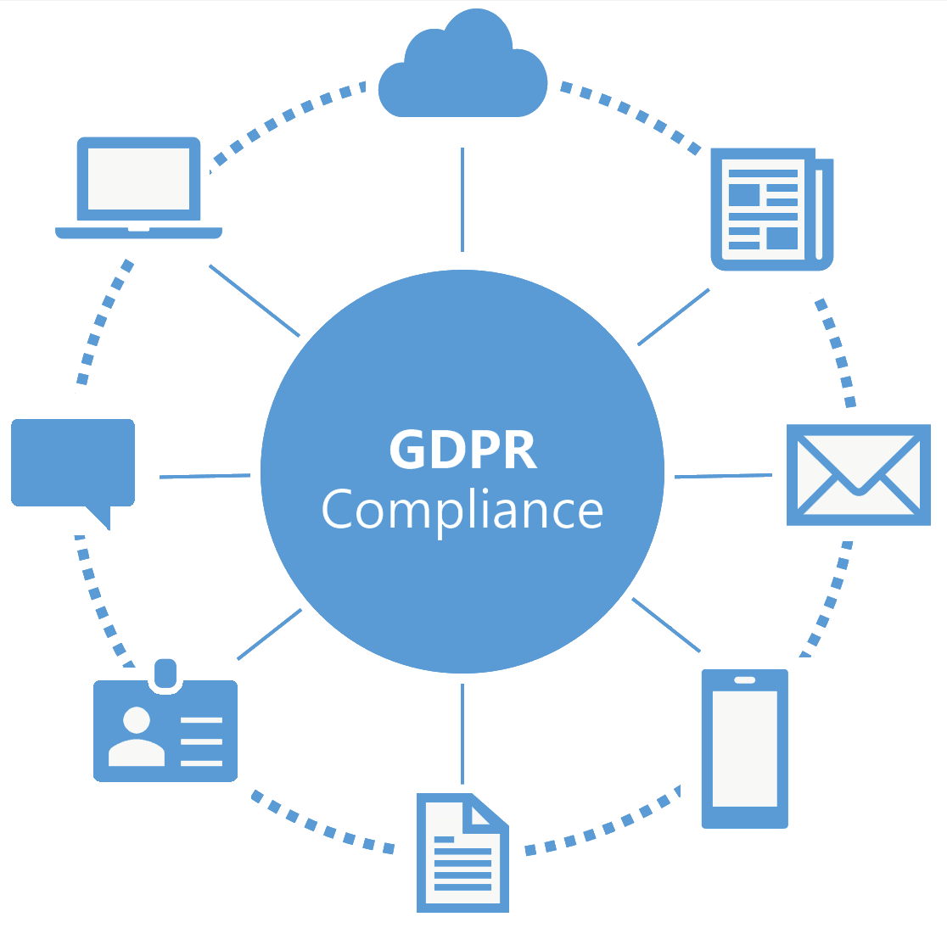

Assessment opportunities
Identify GDPR compliance gaps
Identify maturity along key GDPR scenarios
Identify potential data security and compliance challenges
Determine the current state of personal data security. Discuss and create an actionable data security roadmap for the customer
Notes:
The journey to GDPR compliance starts with understanding the maturity of people, processes and technology at the customer .
The Microsoft GDPR detailed Assessment is focused on this.
It is important to understand that the assessment will not access (personal) data or analyze it, the assessment will look at the people, process and technology the customer uses to work with the data.

Slide 23




Assessment objectives
Understand Customer GDPR compliance objectives
Gain a common understanding of compliance objectives and GDPR requirements
Assess Customer GDPR maturity level
Assess customer’s preparedness to execute on Discover, Manage, Protect, & Report activities
Create a GDPR compliance roadmap
Provide a prioritized and actionable list of next steps and roadmap, ready for legal/advisory review
Notes:
Use the information in the delivery guide to provide more background on the structure of the assessment and the objectives.
Briefly explain the objectives for the assessment:
Understand what the customer wants and needs to become GDPR compliant
Assess the current maturity level, do they for example have processes in place to protect data or report on data breaches?
The outcome of the assessment will be a list of actionable items. Addressing these will help the customer on its journey to GDPR compliance
It is important that the outcome of the assessment and the actions defined are reviewed with a legal focus

Slide 24

Out of Scope
Technical designs or product implementations
Proof of concepts or labs
Recommendations for non-Microsoft technology
Notes:
If partner is providing recommendations for non-Microsoft technology, the slide should be updated.
All activities are focused on assessing maturity of people, process and technology with respect to the GDPR, during the assessments suggestions and activities will be defined to optimize existing or implement new processes and technology. Implementing these suggestions however is not part of this assessment.

Slide 25
Outcomes
From here to there
Where are you today?
Where do you want to go?
Where do you need to go?
How will you get there?
What does success mean to you?
Workshop Outcome
Know and understand GDPR maturity based on the Microsoft GDPR Detailed Assessment
Prioritized, actionable next steps and roadmap towards GDPR compliance
Notes:
The assessment is the start of the journey towards GDPR compliancy. It clearly charts the current situation and will outline actions that will assist in becoming GDPR compliant.

Slide 26



Your responsibilities
Help to Complete Microsoft GDPR Detailed Assessment questions
Provide access to key participants during the assessment
Determine & schedule appropriate audience prior to workshops. This will often include legal, advisory, and senior decision making roles.
Provide executive sponsor
A single executive sponsor is required to oversee and support the engagement
Notes:
The assessment can only be successful if the right people are available to help answer the assessment questions. The quality of the assessment and the usability of the outcome will greatly depend on the accuracy and detail of the answers provided. Having an executive sponsor will help people free time in their calendars and prioritize the assessment activities.

Slide 27
Engagement Overview

Slide 28
Workflow and Schedule
Example
Two weeks ago
Pre-Engagement meeting
Last week
Secure executive sponsor and align resources to complete the Microsoft GDPR Detailed Assessment
Now
Complete the Microsoft GDPR Detailed Assessment,
analyze results and prepare recommendations
Optional
Real-time assessment of the GDPR compliance posture for customers assets in the Microsoft cloud using Compliance Manager
One week from now
Present the findings, discuss remediation and next steps. Deliver prioritized roadmap
Notes:
The time line provided is indicative and needs to be tailored to customers requirements and availability.
The pre-engagement meeting is there to set things in motion and to start the process of identifying the right people and take care of logistics. This usually takes a week.
The actual on-site engagement will start one to two weeks after the online re-engagement meeting and will take an average of 2 on site days.
After completion a close out meeting will be conducted in which the outcome of the assessment will be presented.
Note:
Compliance manager is listed as an optional activity for those customers that already have assets in a Microsoft Cloud Tenant. Remove if not used.

Slide 29
Microsoft GDPR Detailed Assessment Agenda
Example
Workshop | Description | Outcome | Customer attendees | Time | Scheduled time, room
Day 1
Engagement Kickoff | Provides an overview of the 2-day on-site agenda and goals as well as an opportunity to cover Q&A and project governance. | Agreed plan and schedule for the 2-day on-site assessment. Confirm schedule and logistics | All project team | 1 hours | <Time>, <Room>
Start Microsoft GDPR Detailed Assessment | Answer the questions from the Microsoft GDPR Detailed assessment tool | Partially completed GDPR questionnaire | Selected customer responders | 7 hours | <Time>, <Room>
Day 2
Day 1 Review | Review progress from day one, discuss any open items and identified issues. | Ready to move on with completion of the Microsoft GDPR Detailed Assessment. | All project team | 0.5 hours | <Time>, <Room>
Complete Microsoft GDPR Detailed Assessment | Answer the remaining questions in the Microsoft GDPR Detailed Assessment. | Completed GDPR questionnaire | Selected customer responders | 4.5 hours | <Time>, <Room>
Outcome analysis & Write-Up | Review results of GDPR Microsoft GDPR Detailed Assessment, prepare the close out presentation. | Close Out presentation | Compliance Team Partner | 3 hours | <Time>, <Room>
Engagement Closeout
Close Out Presentation | Present findings from the assessment and define next steps and roadmap towards GDPR compliance. | List of next steps and a roadmap with actionable items and timelines, assisting towards GDPR compliancy | All project team | 2 hours | <Time>, <Room>
Notes:
Customize to match your assessment timeframe.
Note
The real-time assessment of the GDPR compliance posture for customers assets in the Microsoft cloud is not included in the agenda, this can be added if required.

Slide 30
Customer Team - Workshop Attendees
Example
Role | Description | Title | Contact information
Project Executive Sponsor (CPO, CISO, DPO) | Executive sponsor who is responsible for driving the strategic vision for the organization & making key decisions Ultimate authority and accountability for the project and delivery on project objectives Helps resolve issues escalated by project team Sponsors communication within the company regarding project goals and deliverables Provides guidance and clarity regarding overall security strategy, standards and policies for the organization
Project Manager | Coordinates partner and working teams engaged in the project Schedules all meetings with appropriate resources Is the central point for dissemination of the engagement deliverables Records and manages project issues, including escalations Liaises with, and provides updates to, project executive sponsors Ensures that the on-site requirements are met in time for the 2-day on-site workshops
Enterprise, Compliance and/or Privacy Architects | Responsible for compliance and privacy strategy defined by the organization Analyses and chooses products for the organization that meets business goals Accountable for creating and maintaining the compliance architecture Responsible for operation of compliance and privacy products Provides insights into current and planned compliance and privacy guidelines, requirements and standards for the organization
Privacy & Compliance Specialists | Responsible the deployment, operations and maintenance of security solutions Provides technical knowledge on how existing security controls have been implemented
Notes:
Update team member titles and names during the workshop.

Slide 31
Partner Team - Workshop Attendees
Example
Role | Description | Title | Contact information
Project / Engagement Manager | Develops and maintains project timeline Coordinates partner and working teams engaged in the project Manages project deliverables Records and manages project issues, including escalations Liaises with, and provides updates to, customer Project Manager
Compliance & Privacy Architects / Consultants | Prepares the workshop materials and delivers the 2-day Microsoft GDPR Detailed Assessment Accountable for creating the engagement deliverables
Notes:
Update team member titles and names prior to the workshop.

Slide 32
The Microsoft GDPR Detailed Assessment Tool

Slide 33
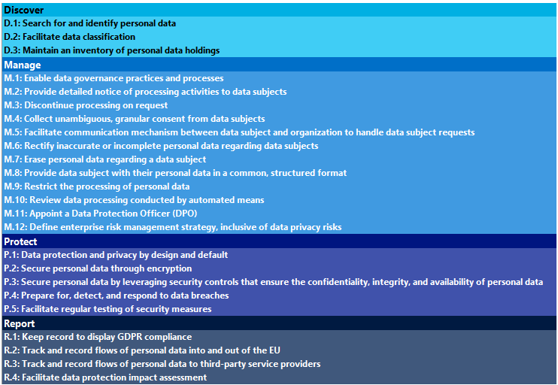
GDPR Detailed Assessment Tool - Input
Questionnaire of 150+ questions
Structured around four vital areas
Discover, identify what personal data you have and where it resides
Manage, govern how personal data is used and accessed
Protect, establish security controls to prevent, detect, and respond to vulnerabilities and data breaches
Report, execute on data requests, report data breaches, and keep required documentation
Questions have a weighting that counts towards the maturity score and stage
The tool generates recommendations and provides refences to GDPR articles
Notes:
To prepare customers for the assessment provide insight into the tool and discuss questions around the four themes.
This slides provides insight in the type of questions the customer can expect, if more detail is needed the next four hidden slides can be used.

Slide 34
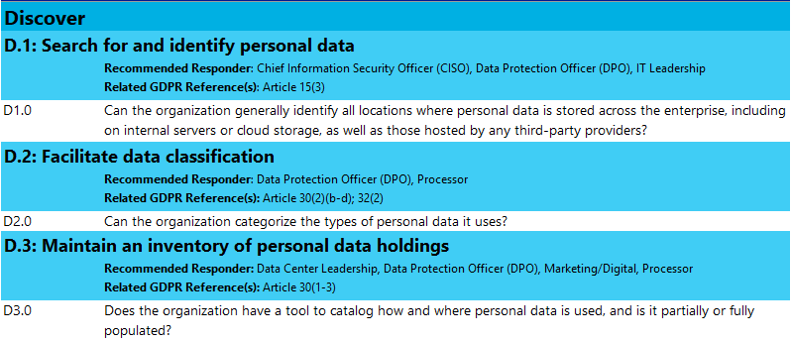
Questionnaire -Discover
Example
Notes:
This OPTIONAL slide can be included if additional detail is needed on the questionnaire, it includes the knock out questions that describe the scenario.
Unhide and present if needed

Slide 35
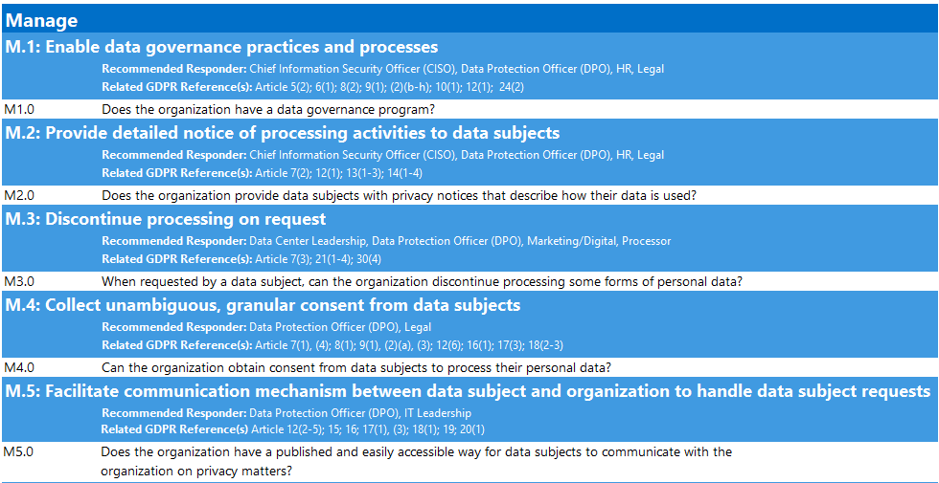
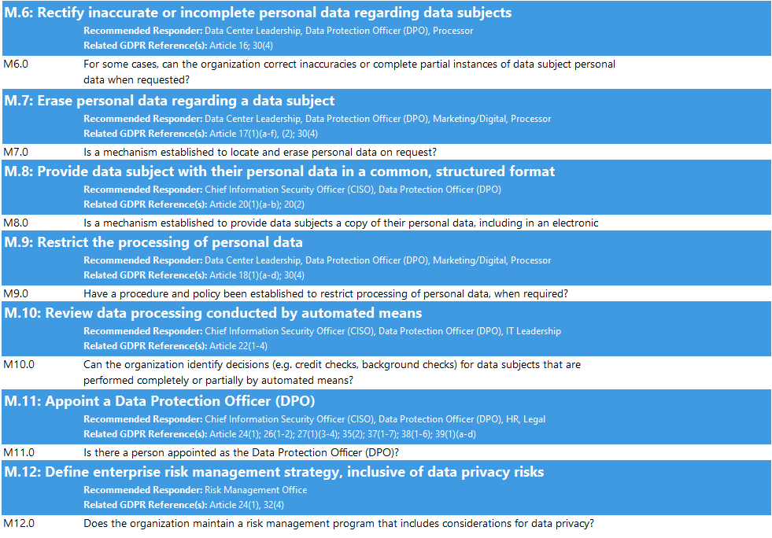
Questionnaire -Manage
Example
Notes:
This OPTIONAL slide can be included if additional detail is needed on the questionnaire, it includes the knock out questions that describe the scenario.
Unhide and present if needed

Slide 36
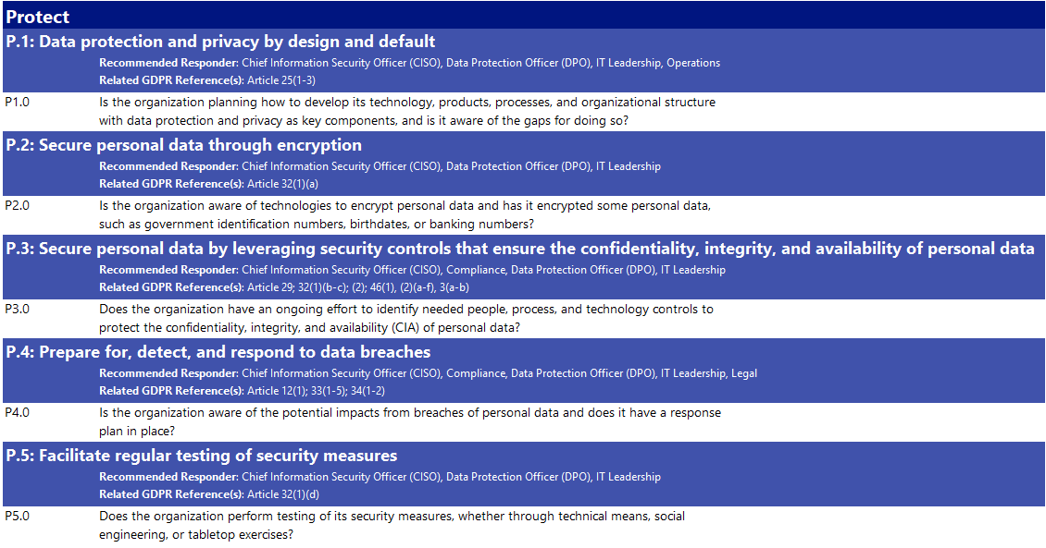
Questionnaire - Protect
Example
Notes:
This OPTIONAL slide can be included if additional detail is needed on the questionnaire, it includes the knock out questions that describe the scenario.
Unhide and present if needed

Slide 37
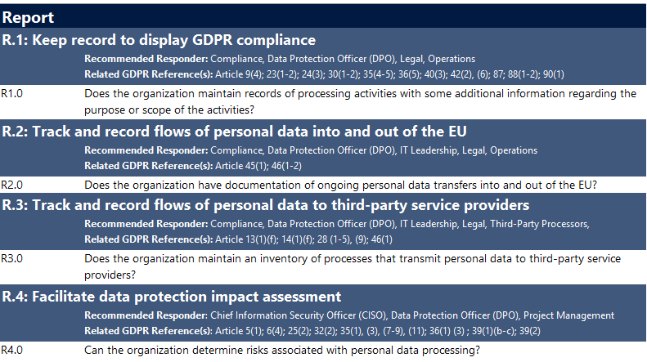
Questionnaire - Report
Example
Notes:
This OPTIONAL slide can be included if additional detail is needed on the questionnaire, it includes the knock out questions that describe the scenario.
Unhide and present if needed

Slide 38
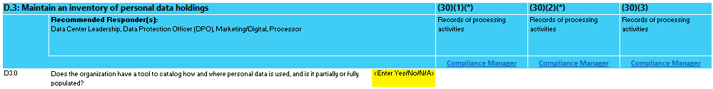
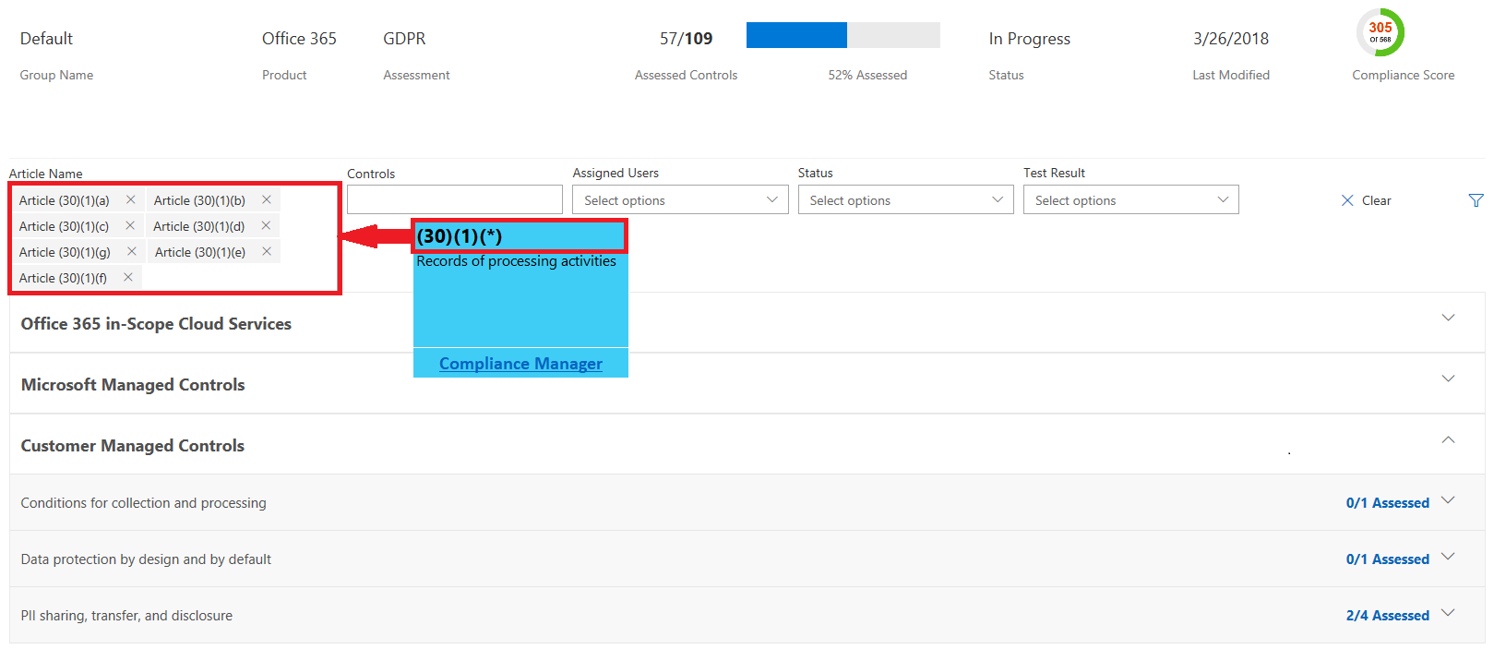
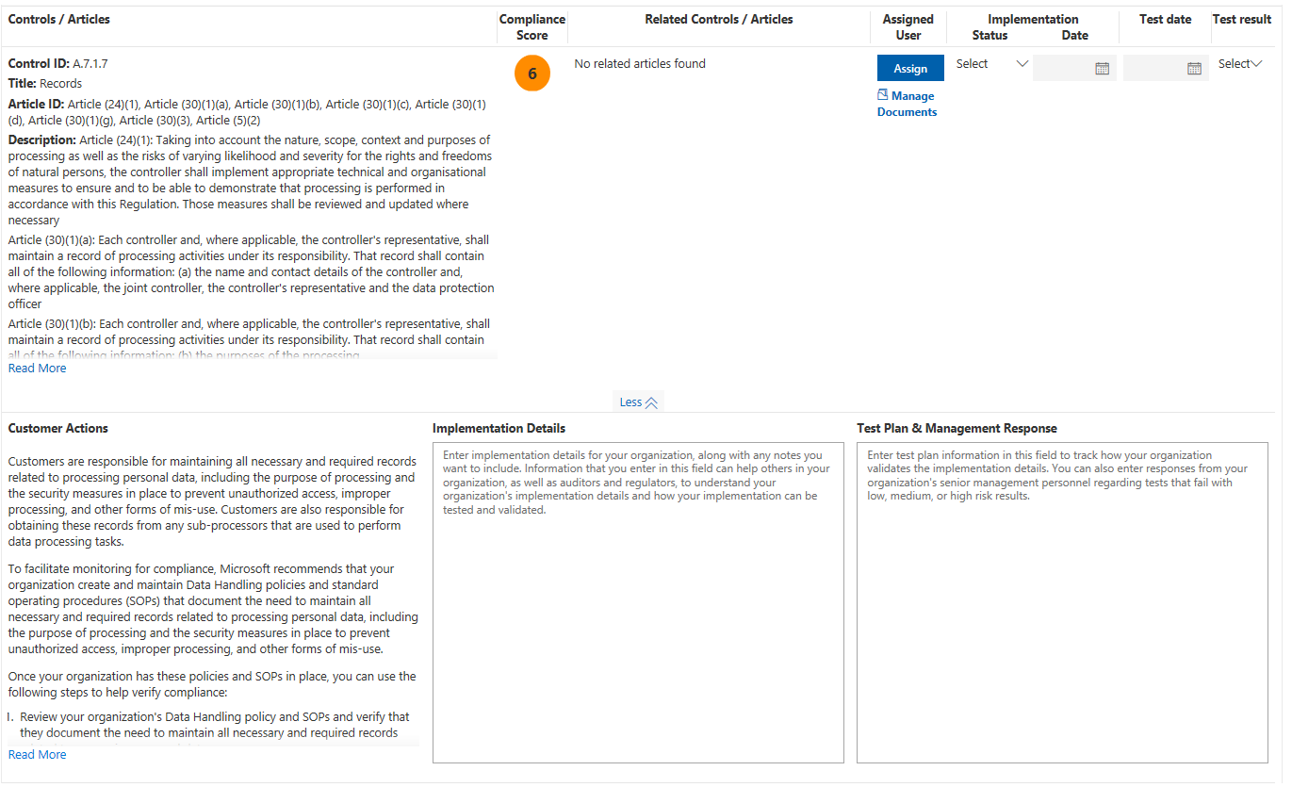
Compliance Manager integration
Optional activity
GDPR article references
Every sub-scenario provides statutory references to relevant GDPR articles
Per article links to relevant Compliance Manager controls
Compliance Manager
Real-time assessment of the GDPR compliance posture for customers assets in the Microsoft cloud
Actionable insights into both customer’s and Microsoft’s responsibility to meet compliance standards
Documented customer actions
Task delegation and assignment
Tracking and evidence gathering
Notes:
The GDPR Detailed assessment offers integration with Microsoft Compliance Manager.
For every sub-scenario under Discover, Manage, Protect and Report, the applicable GDPR articles are referenced.
For every article a link to compliance manager is provided that when clicked, will open a filtered view of the Compliance Manager dashboard. The dashboard will show both Microsoft and Customer controls that are relevant to the GDPR article referenced.
Note
Compliance manager requires a Microsoft cloud tenant. Preferably the customers production tenant is used.
Compliance manager is listed as an optional activity for those customers that already have assets in a Microsoft Cloud Tenant.
Remove or hide slide if not used.

Slide 39
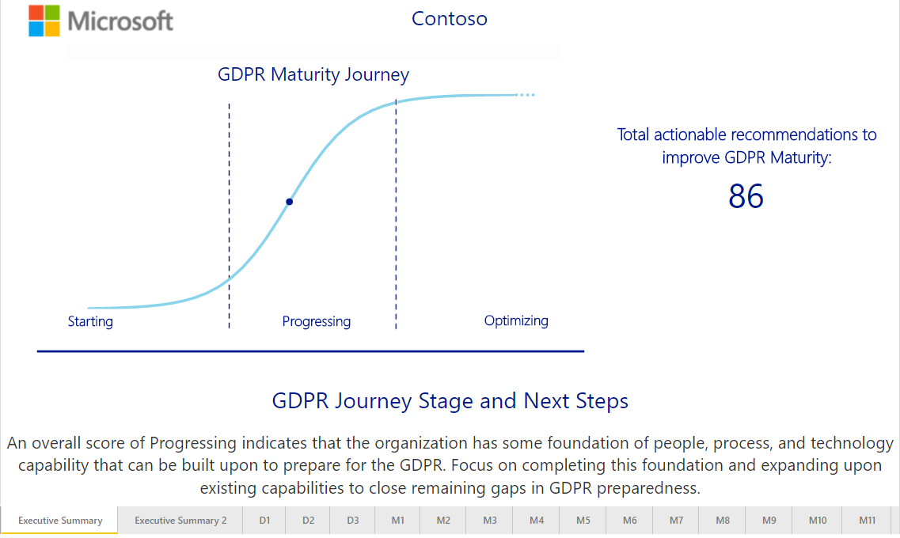
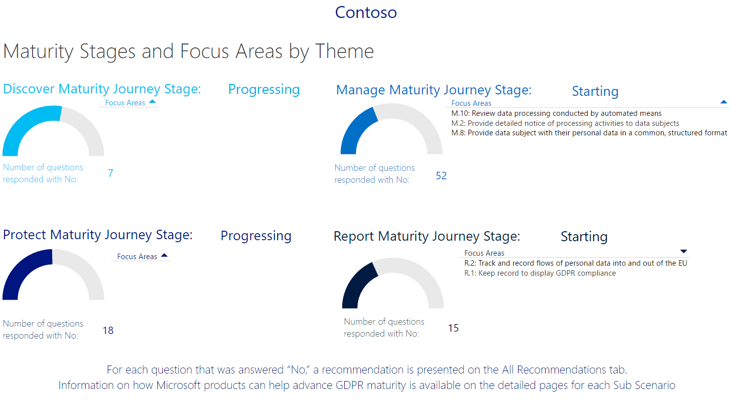
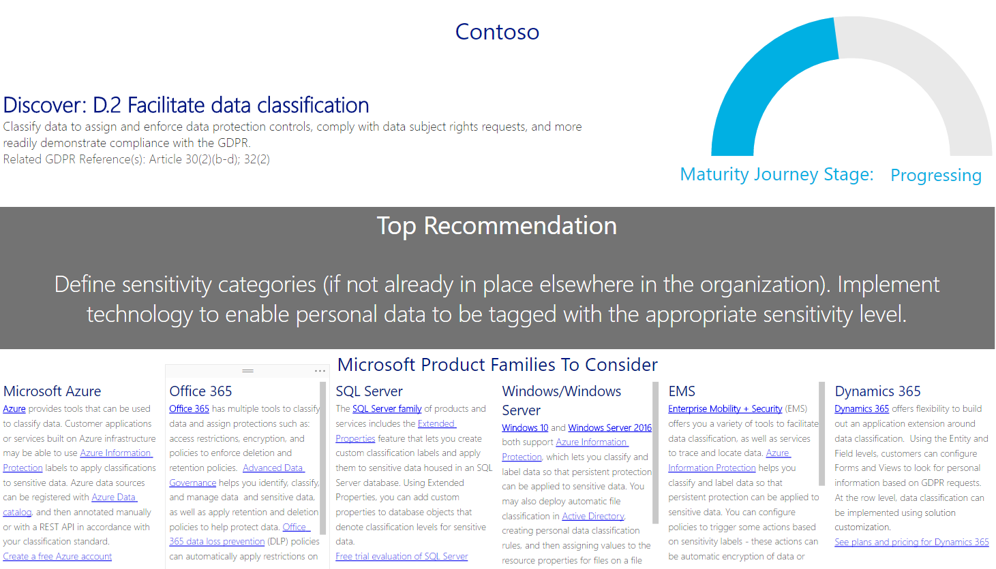
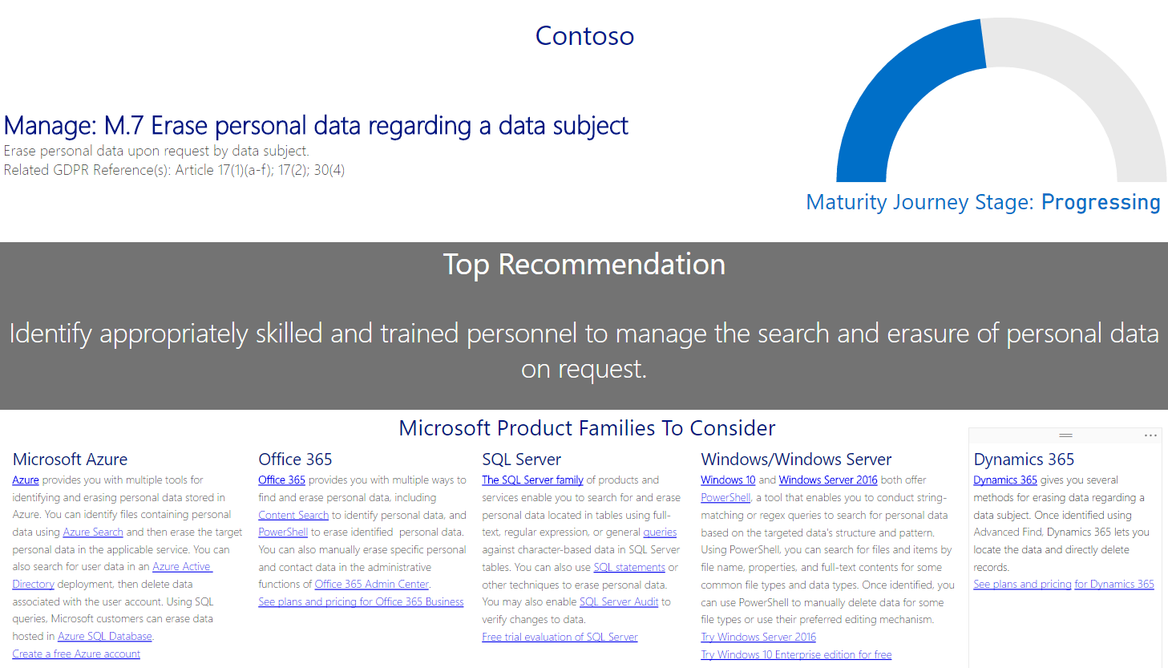
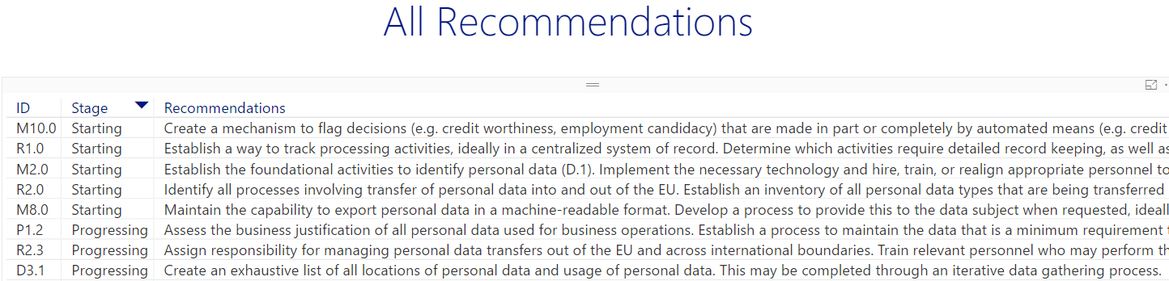
GDPR Detailed Assessment Tool - Output
Executive summary
Aggregated across all four DMPR themes
Overall maturity of one of three levels: Starting, Progressing or Optimizing
Results per theme and focus area
Detailed insights per theme
Maturity index
Top recommendation per sub scenario
Microsoft Product suggestions
All Recommendations
Comprehensive and actionable list
Full list of recommendations
Grouped by sub-scenario and GDPR maturity stage
For each theme and sub scenario
Notes:
Discuss the outcome of the tool and highlight the three types of information provided (Executive, Detailed and All Recommendation)

Slide 40
Project Governance

Slide 41
Project Governance Update
Example
Risk and issues management
Covering business, technology and project execution
Describe the escalation path
Change management
Describe the change management workflow
Success Criteria
Discuss and agree on what a successful engagement would look like
Date recorded | Risk/Issue description | Probability | Impact | Mitigation plan
Notes:
Discuss overall project governance and make sure to document risks/issues as well as success criteria for the engagement.

Slide 42
Q&A

